Slide 1


Leveraging Spatial Data and Generative AI for Optimal Business Location Selection
Thesis Framework Proposal
Giorgos Kakepakis - 03198
Professor: E. Houstis

Slide 2

“Mechanism for the Optimal Location of a Business” ~ article
Inspired by the Department of Planning and Regional Development research performed and paper written
Manually assigned weights to create a predictor model, extracted the following conclusions:
Importance of commercial center for urban shrinkage
Model predictions approximate reality
Different weights assigned per branch
Compared with businesses active 4-years or more

Slide 3
Machine Learning Integration
1
NLP
2
Predictions
Understanding the prompt of a user contextually
Using ML models to make predictions based on data
3
Generative AI
4
Databases
User gets a contextual and cohesive response
Dynamic system based on our candidates

Slide 4
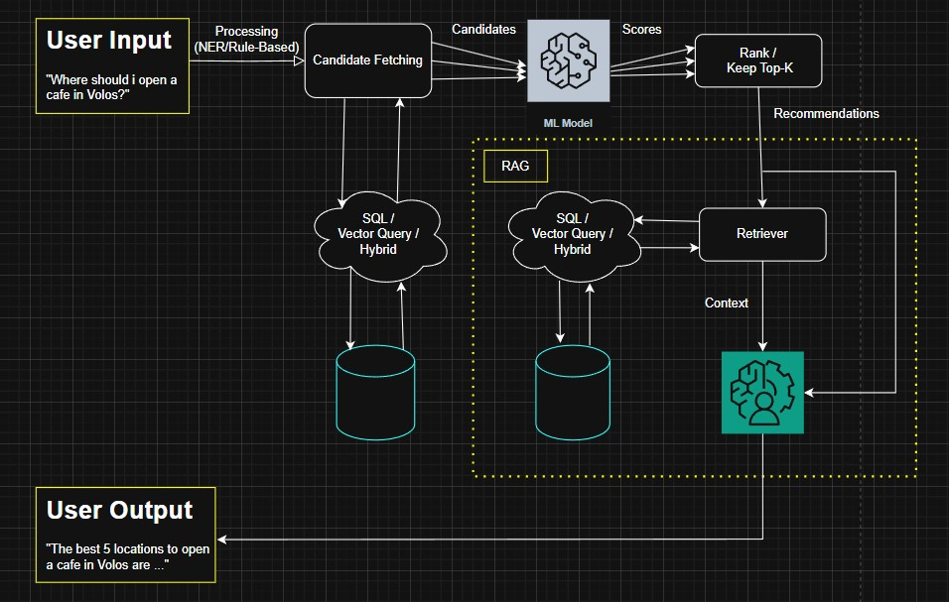
Suggested Framework

Slide 5
User Input

Slide 6
User Input
Regular text expression: “Where can I open a café in Volos?”
We need valid candidate locations
Processed to create a database query
Rule-Based query for SQL database (NER)
Embedding for Vector database
Hybrid approach

Slide 7
Candidate Fetching

Slide 8
Candidate Fetching
Query the database(s) to get the candidates
Hybrid approach can be implemented in different ways
SQL and vector database in parallel and combination of their results
SQL querying initially and vector search on the results for speed and ending up with less candidates
We end up with the candidate locations to be evaluated

Slide 9
Machine Learning Model

Slide 10
Machine Learning Model
ML model trained on historical data to predict a success indicator
Deep Learning model
Gradient Boosting model
Other …
Scores used as ranking criteria
We keep only the top-k scores as the final suggestions

Slide 11
Retrieval-Augmented Generation (RAG)

Slide 12
Retrieval-Augmented Generation (RAG)
We query a database to get relevant data for each candidate (documents/data)
We pass them as a combined prompt to the LLM to generate the final output
Gives context for the suggestions
Allows LLM to use domain-specific information
Makes the model able to update the information
Gives more interpretable responses to the user
Final output passed back to the user

Slide 13
Suggested Framework Recap
Candidate Fetching
ML Scoring Model
User Input
RAG
“Where can I open a café in Volos?”
Ranking based on scores, keeping top-K (e.g. 5)
Final output “The top 5 locations to open a café in Volos are: …”
N candidates (e.g. 50)

Slide 14
Dynamic Behavior of the System

Slide 15
Dynamic Behavior of the System
The ML model and the LLM are trained once
We can just update the databases to make the system suitable for predictions in different cities
Add candidates for other cities (e.g. Athens)
Add documents for other cities for RAG
The workflow is identical -> dynamic based on the entries of the databases

Slide 16
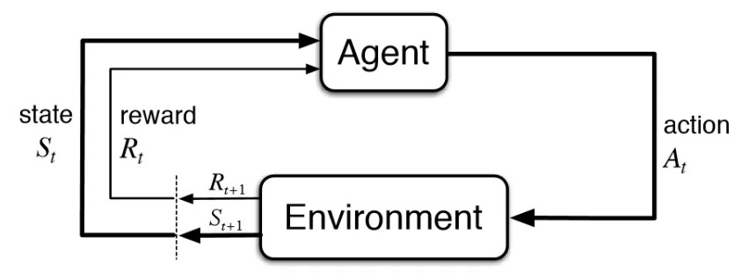
Future Direction – Reinforcement Learning
Integration of a Reinforcement Learning agent, possibly instead of the ML model
RL agents can learn by feedback
From simulations
From real-world applications
RL algorithms: Q-learning/Deep Q-Networks (DQN)/Proximal Policy Optimization (PPO)

Slide 17
Questions
Candidates Database
01
Real/synthetic data?
02
ML model training data
Only active years exist as a success indicator, not economic
Multiple Databases
03
Do we need a different database for RAG (documents)
04
LLM fine-tuning
Should it be implemented and is it possible?
Time
05
When is the project expected to finish?

